Slide 1
AE
2020寒訓

Slide 2
AE
資料集使用MNIST，示範model架構為DNN的Autoencoder。
實作CNN的Autoencoder
Functional API用起來

Slide 3
Load data and preprocessing
from keras.datasets import mnist
import numpy as np
(x_train, _), _ = mnist.load_data()
x_train = x/255
x_train = x_train.reshape((x_train.shape[0], -1))

Slide 4
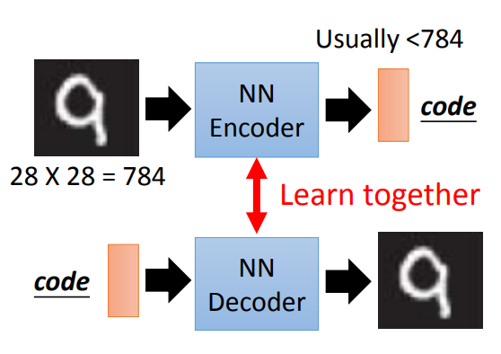
Autoencoder

Slide 5


Build model
From sequential API to functional API
model使用functional API搭建

Slide 6
Encoder - DNN
input_img = Input(shape=(x_train.shape[1], ))
x = Dense(128, activation='sigmoid')(input_img)
x = Dense(64, activation='sigmoid')(x)
encoded = Dense(32, activation='sigmoid')(x)
encoder = Model(input_img, encoded)
encoder.summary()

Slide 7
Decoder - DNN
input_code = Input(shape=(32, ))
x = Dense(64, activation='sigmoid')(input_code)
x = Dense(128, activation='sigmoid')(x)
decoded = Dense(784, activation='sigmoid')(x)
decoder = Model(input_code, decoded)
decoder.summary()

Slide 8
Autoencoder
output = decoder(encoder(input_img))
autoencoder = Model(input_img, output)
autoencoder.summary()
autoencoder.compile(optimizer='adam', loss='binary_crossentropy')
autoencoder.fit(x_train, x_train, epochs=64, batch_size=256, shuffle=True, validation_split=0.1, verbose=1)

Slide 9
Predict and show result
decoded_img = autoencoder.predict(x_train)
n=10
plt.figure(figsize=(20, 4))
for i in range(n):
ax = plt.subplot(2, n, i+1)
plt.imshow(x_train[i].reshape(28, 28))
plt.gray()
ax.get_xaxis().set_visible(False)
ax.get_yaxis().set_visible(False)
ax = plt.subplot(2, n, i+1+n)
plt.imshow(decoded_img[i].reshape(28, 28))
plt.gray()
ax.get_xaxis().set_visible(False)
ax.get_yaxis().set_visible(False)

Slide 10
Remember to import!!
import matplotlib.pyplot as plt
from keras.models import Model
from keras.layers import Input, Dense

Slide 11
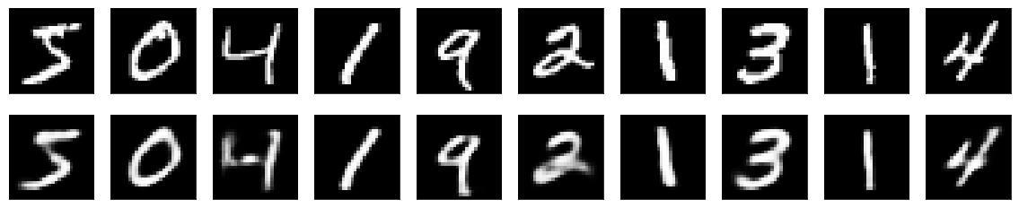
Result

Slide 12
AE Practice
把所有的#TODO都解決掉吧~
說明、練習與提示
Code

Slide 13
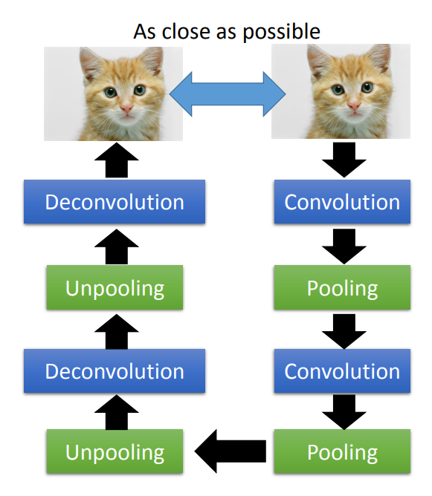
AE with CNN

Slide 14
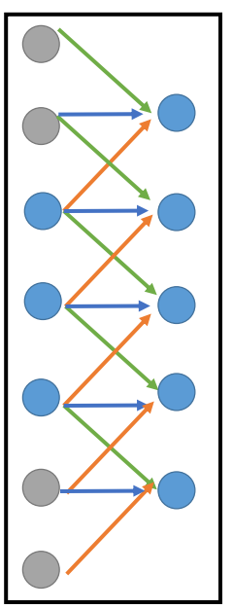
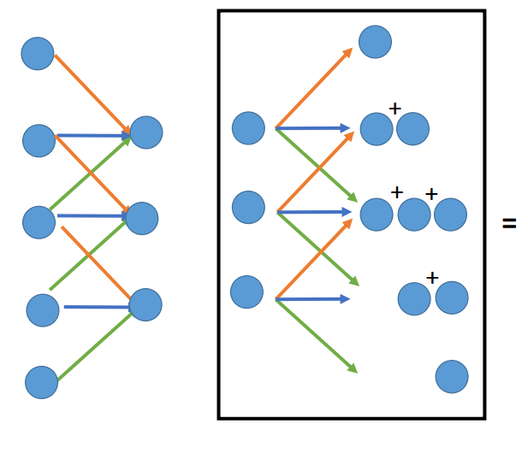
Deconvolution?

Slide 15
Load data and preprocessing
(x, _), _ = mnist.load_data()
把x的0~19999筆為x_train
做normalization（方法是?）

Slide 16



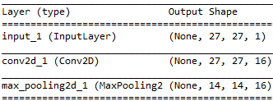
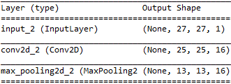
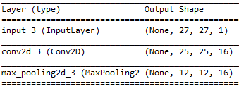
Encoder
3層conv2d&maxpooling2d,
filter數分別為16, 8, 8
kernel size=(3, 3)
maxpooling size=(2, 2)
二者padding=’same’
activation=’tanh’
後接1層dense
unit=2
activation=’tanh’
接一個CNN
padding=’same’使得layer的output shape不會變小

Slide 17
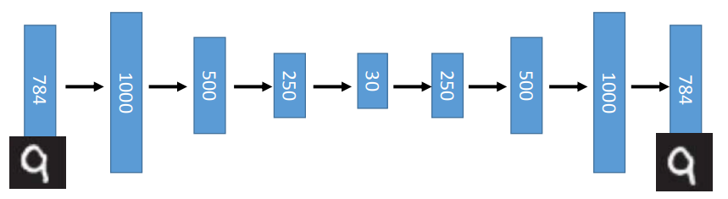
Decoder
Deconvolution依舊使用Con2D
MaxPooling2D改成UpSampling2D
架構（filter個數?層數?）要跟encoder相反
為了使shape跟原大小相符，適當刪掉padding=’same’

Slide 18
After decoder
model.complie()，loss是什麼?為什麼?
Model的input和output分別是什麼?

Slide 19
Predict and show the result
funciton參考： np.linspace() np.meshgrid() np.concatenate()
開一個大的空白矩陣，將對應位置的predict結果填到矩陣內

Slide 20
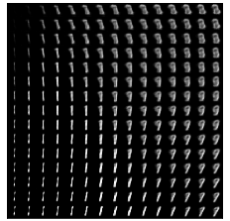
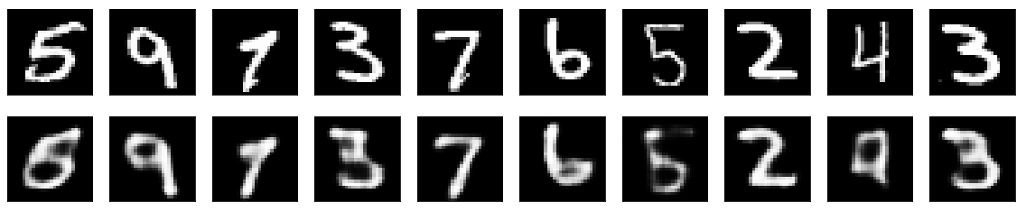
Example result

Slide 21
Extended thinking
Model的reconstruct效果有像上個投影片好嗎? 為什麼?
有什麼辦法可以提升model的效果?

